Slide 1

Customer Churn Analysis
Team 4: Alysia Tran, Trevor Rubino, Yousef AlSadhan, Shraddha Mahangare
Watch Now!

Slide 2
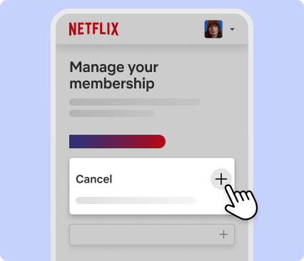
Agenda
Business Problem / Objectives
Dataset Description
Exploratory Analysis
Predictive Modeling
Challenges
Insights & Conclusion
1
2
3
4
5
6

Slide 3
01
Business Problem
1

Slide 4
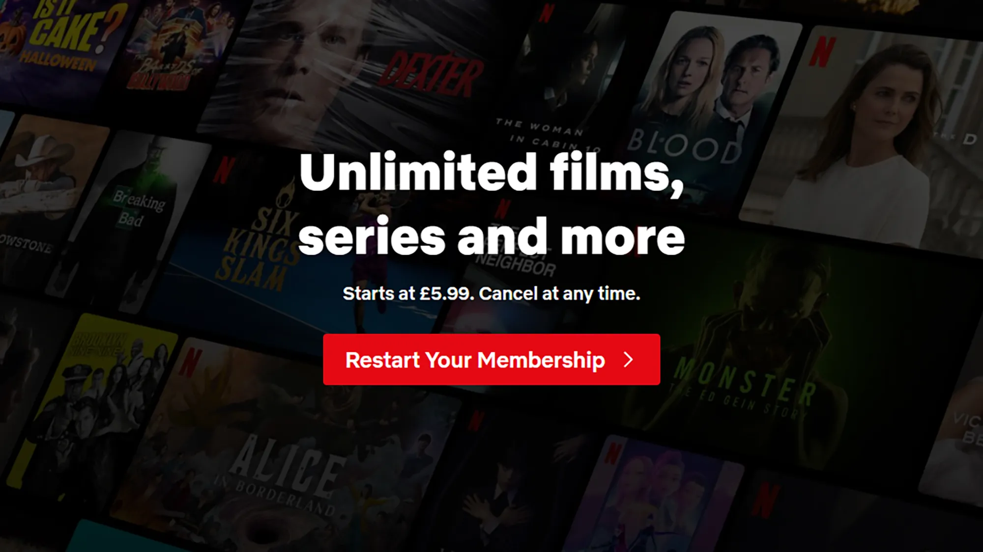
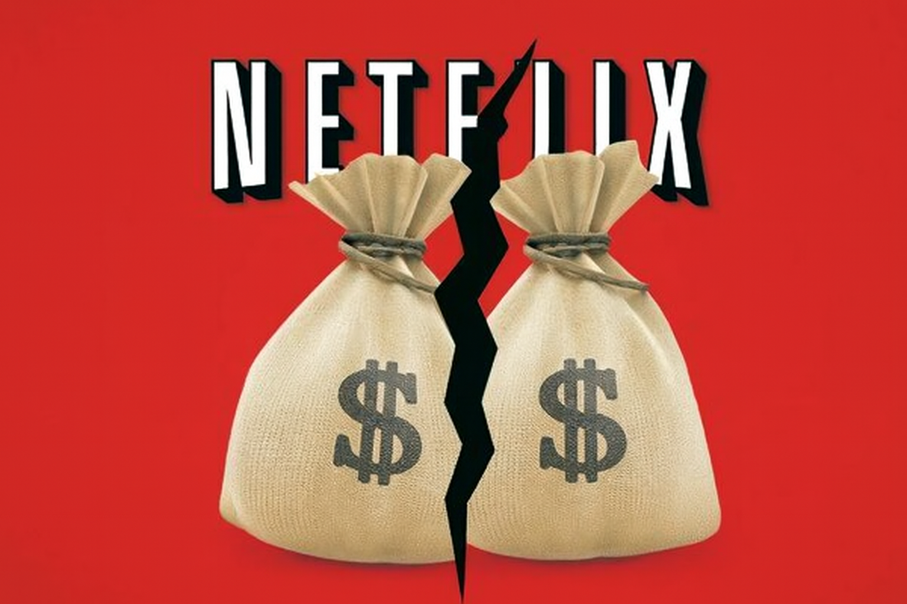
Business Problem
Netflix is facing rising competition and needs a proactive, data-driven approach to reduce subscriber churn. The company must identify high-risk users early and deliver personalized retention efforts to keep them engaged and loyal.

Slide 5
Objectives
01
Demographics
02
Subscriptions
03
Prediction
04
Retention
Identify core customer demographics
Analyze subscription tiers and churn impact
Build a model to predict churn-risk subscribers
Recommend targeted strategies to reduce churn and protect revenue
Notes:
1. Understand the demographics of subscribers?
2. Most popular subscription types and how it impacts churn
3. Predict which Netflix subscribers are most likely to churn using machine learning.
4. Support Netflix in designing targeted retention strategies for high-risk subscribers and reduce revenue loss as customer retention is more profitable than customer acquisition.

Slide 6
01
Dataset Description
2

Slide 7
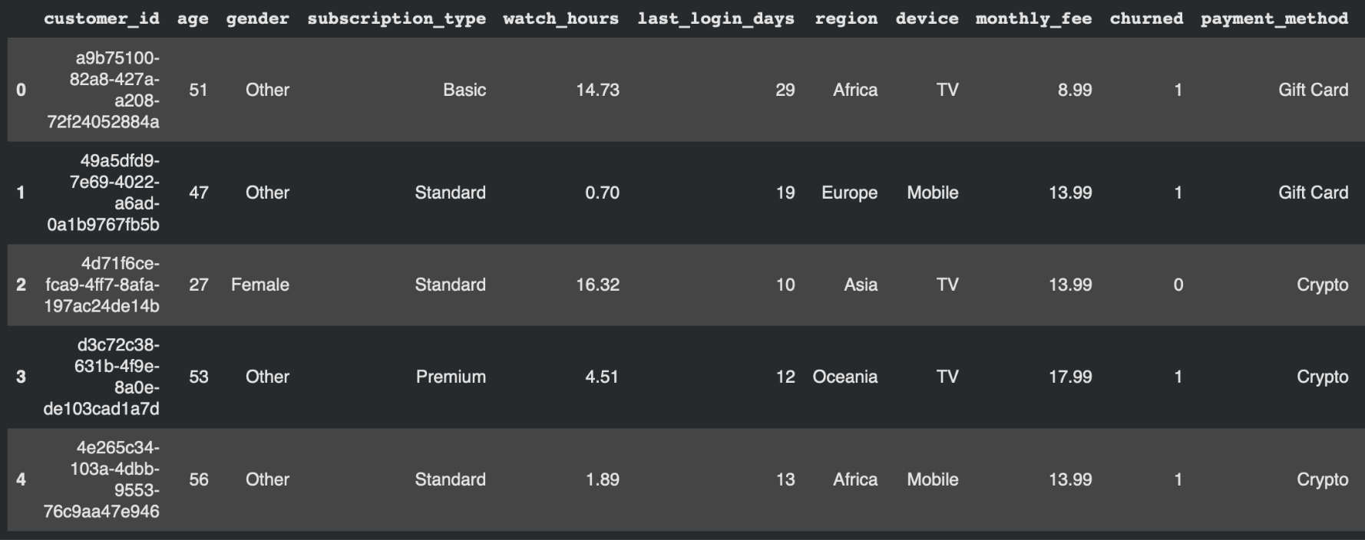
Dataset Description
Source: Netflix User Data From Kaggle
5000 Records & 14 Variables
Columns include: 'customer_id', 'churned', 'age', 'gender', 'subscription_type', 'watch_hours', 'last_login_days', 'region', 'device', 'monthly_fee', 'payment_method', 'number_of_profiles', 'avg_watch_time_per_day', 'favorite_genre'

Slide 8
01
Exploratory Analysis
3

Slide 9
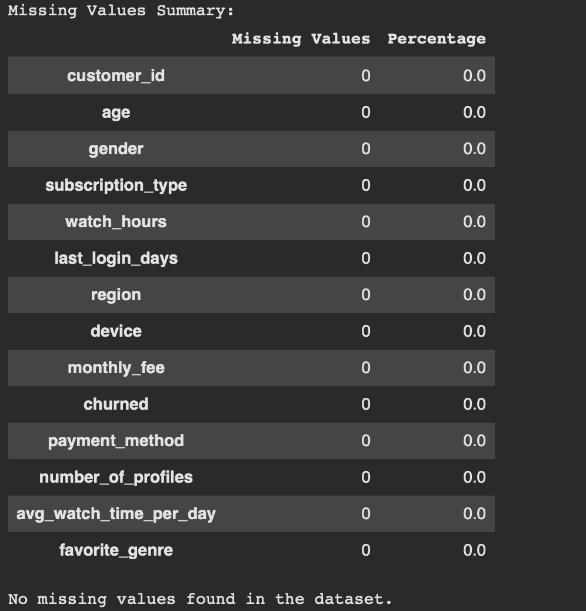
Data Cleaning
Load data into Google Colab
Check for missing values, duplicates and convert categorical values to binary using One-hot coding
Drop unwanted column like customer_id
1
2
3

Slide 10
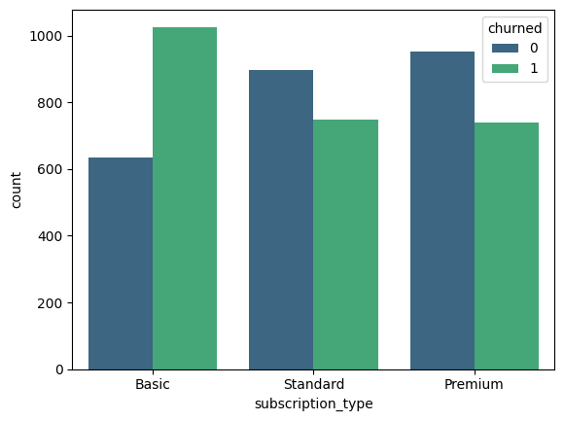
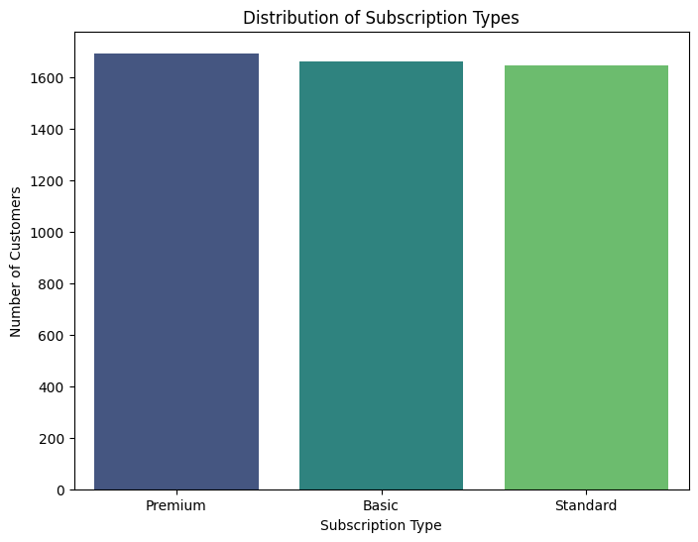
Subscription Type vs Churn Rate (Cancelled)
Basic
Standard
Premium
61.83%
45.44%
43.71%
Notes:
Customers on the Basic subscription plan have the highest churn rate ($\mathbf{61.83\%}$). This is significantly higher than the Standard ($\mathbf{45.44\%}$) and Premium ($\mathbf{43.71\%}$) tiers.

Slide 11
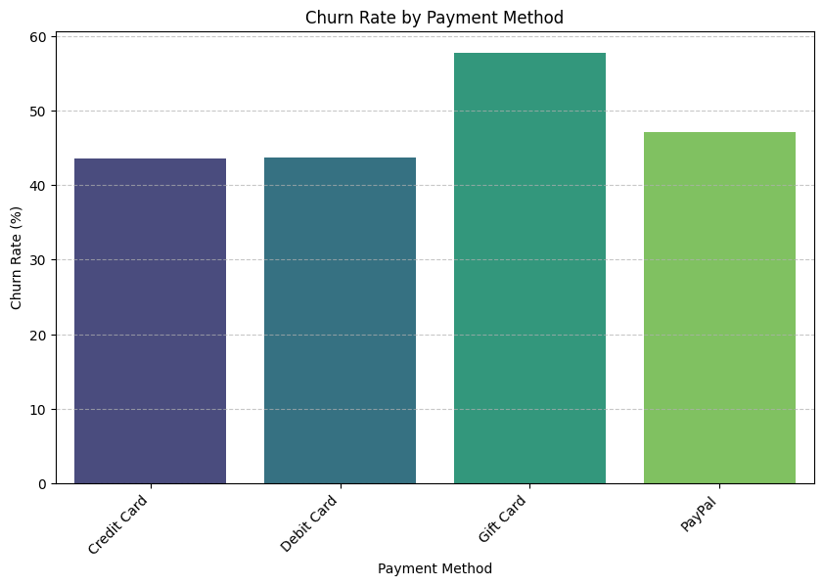
Churn vs Payment Method
Highest churn rate
Gift cards
Lowest churn rate
Debit and credit cards
Notes:
The business should investigate potential friction points with the high-risk payment methods. For example, are Gift Card and Crypto users single-purchase, non-recurring subscribers? Are there issues with automatic renewal for these methods? Optimizing the billing experience for these segments is a key retention opportunity.

Slide 12
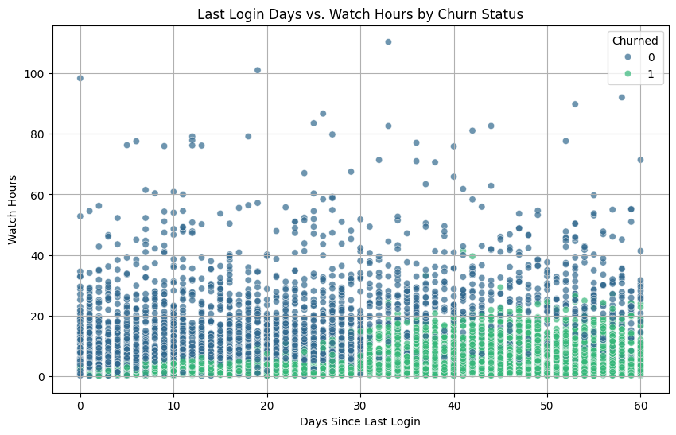
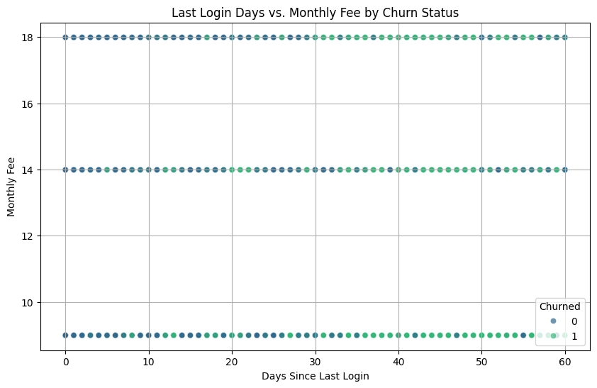
Last login days vs Churn

Slide 13
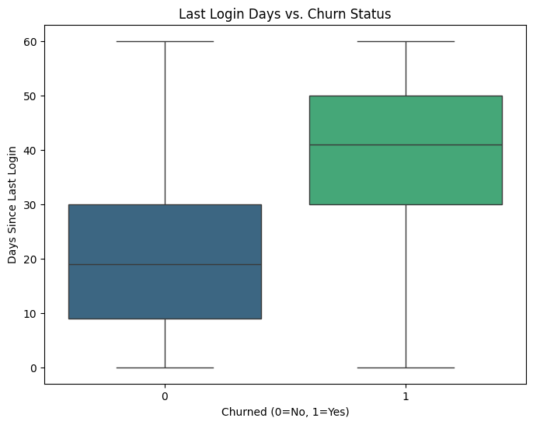
Churn vs Last Login Date
Churn customers
Average of 40 days
Non-churned customers
Average of 20 days

Slide 14
01
Predictive Modeling
4

Slide 15
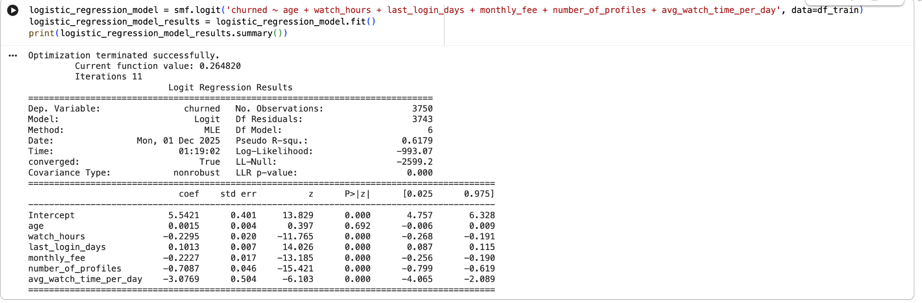
Feature Selection
Target variable: Churn (1/0)
Select most significant features using Logit function
Most significant features are: Watch hours, Last login, Monthly fee, Number of profile, Average watch time per day

Slide 16
Modeling
Split Data into training and testing dataset
Train Data - 75%
Test Dataset - 25%
Logistic Regression Model
Model Training
Use Logistic Regression() function to train the model on patterns from train dataset and to predict target variable from the same
Prediction & Evaluation:
The model predicts churn for the unseen test data.
Accuracy: 89.12%
Notes:
Your model is almost perfectly distinguishing churned vs. non-churned users.
The data has very strong signal — possibly due to a well-engineered feature space and minimal noise.

Slide 17
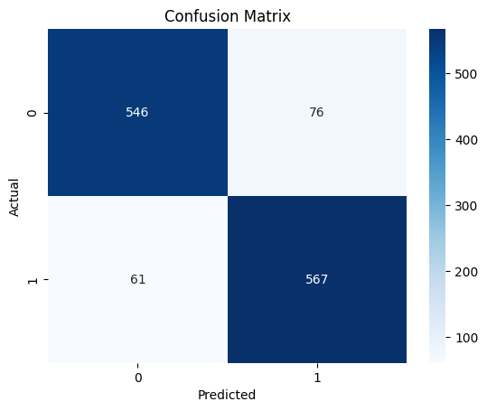
Modeling
Logistic Regression Model
Prediction Accuracy
89.12%
Correlation Matrix
True Negatives
False Positives
546
76
False Negatives
True Positives
61
567

Slide 18
Modeling
Is 89.12% good?
Comparing our model with baseline model
Baseline Model Accuracy: 0.5024
accuracy = (TP + FN) / (TP + TN + FP + FN)
The logistic regression model improves over the baseline model.
Notes:
Your model is almost perfectly distinguishing churned vs. non-churned users.
The data has very strong signal — possibly due to a well-engineered feature space and minimal noise.

Slide 19
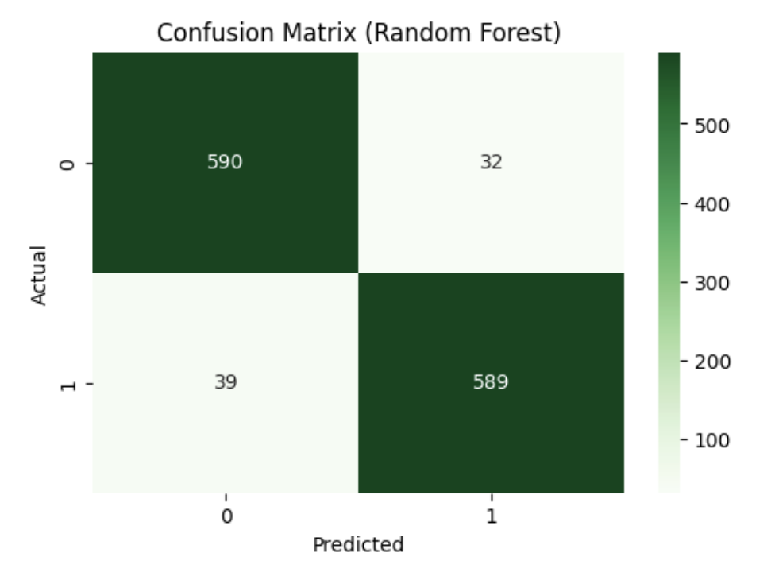
Modeling
Random Forest Model
Prediction Accuracy
94.32%
Correlation Matrix
Highest predictive accuracy
True Negatives
False Positives
590
32
False Negatives
True Positives
39
589

Slide 20
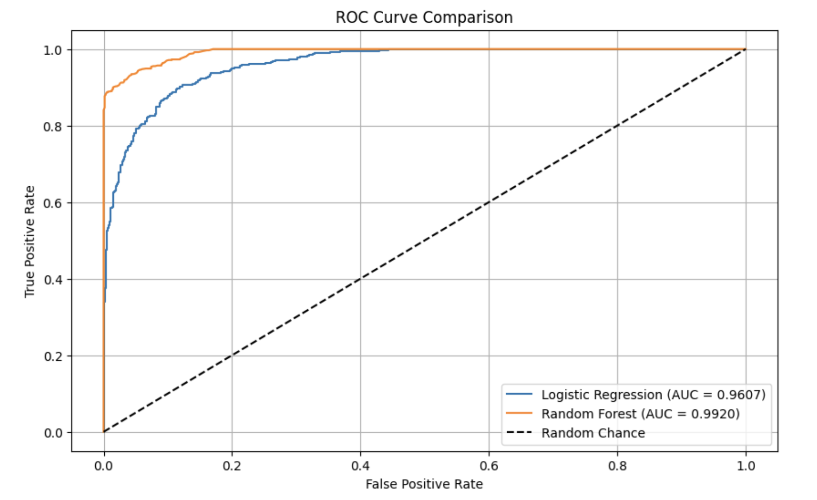
Model Score Comparison
Score | Logistic Model | Random Forest Model
Overall Accuracy | 0.8912 | 0.9432
Recall TP/(TP+FN) | 0.9268 | 0.937898
Precision TP/(TP+FP) | 0.8818 | 0.9484
F1 | 0.9417 | 0.943155
ROC | 0.9607 | 0.9920
Notes:
Your model is almost perfectly distinguishing churned vs. non-churned users.
The data has very strong signal — possibly due to a well-engineered feature space and minimal noise.

Slide 21
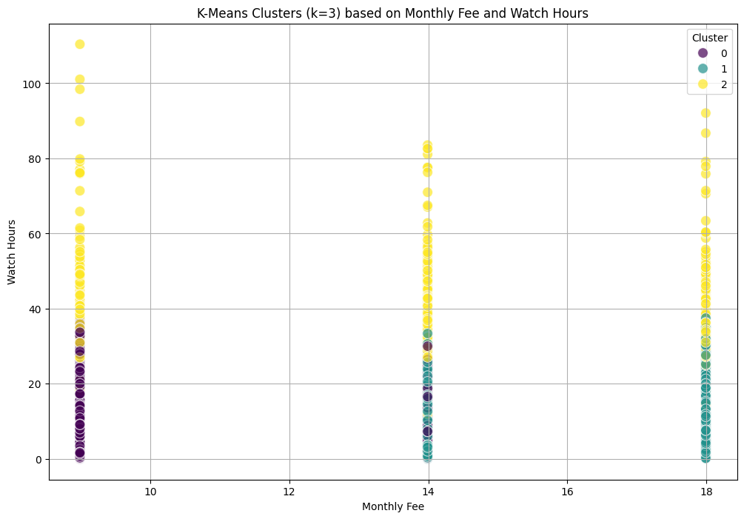
K-means clustering
Cluster 0: Casual users at risk of churning
Cluster 1: Inactive customers
Cluster 2: Highly engaged customers
~25 watch hours, 42% churn rate
~12 watch hours, 90% churn rate
~59 watch hours, low churn rate 9%
Notes:
Churned is our target variable, watch hours and last login tiome
Our optimal amount of cluster is 3
We wanted to visualize onthly_fee vs. watch_hour
High Monthly Fee, High Watch Hours Cluster: This cluster might represent engaged, high-value customers.
Low Monthly Fee, Low Watch Hours Cluster: This might represent casual users or those at risk of churning due to low engagement.
High Last Login Days, High Churn Rate Cluster: This cluster would likely indicate customers who are already inactive and very likely to churn.
The high-risk subscriber cluster is Cluster 1, with a
90\%
churn rate. Its primary characteristics are prolonged inactivity (average of 74 days since last login) and minimal viewing habits (average of 12 watch hours).
To design targeted retention strategies to reduce revenue loss:
For High-Risk (Cluster 1): Focus on re-engagement campaigns and personalized offers to inactive and disengaged customers.
For Moderate-Risk (Cluster 0): Implement proactive engagement strategies to prevent these customers from moving into the high-risk category.
For Low-Risk (Cluster 2): Target these highly engaged customers for premium upgrades or loyalty programs to maximize their lifetime value.

Slide 22
01
Challenges
5

Slide 23
Challenges
Small Dataset
Synthetic Dataset (Unable to analyze real Human Behavior)
Lacking variables

Slide 24
01
Insights & Conclusion
6

Slide 25
Insights
Overall dataset had high churn rate
Customers with lower engagement, had higher churn
Higher-tier subscriptions had lower churn
Random forest was the most accurate model at 94%
Age and Gender were not significant

Slide 26
Business Recommendations
Utilize churn model to segment subscribers into groups
Deploy targeted marketing strategies and personalized incentives to groups to reduce Churn
Consider creating retention offers to upgrade Basic customers to Standard/Premium plans.
Notes:
The business should prioritize identifying the root causes (e.g., competitor offerings, service quality, pricing dissatisfaction) and launching broad retention initiatives.
Are Basic tier features too limited?
Are these customers extremely price-sensitive and easily swayed by competitors?

Slide 27
What additional data that would be useful
More rows of data
Price increase of subscription cost
Reason why someone is cancelling
Success rate of marketing emails
Data on Date-joined / (Date-cancelled)
Length of session durations on Netflix

Slide 28
